Slide 1

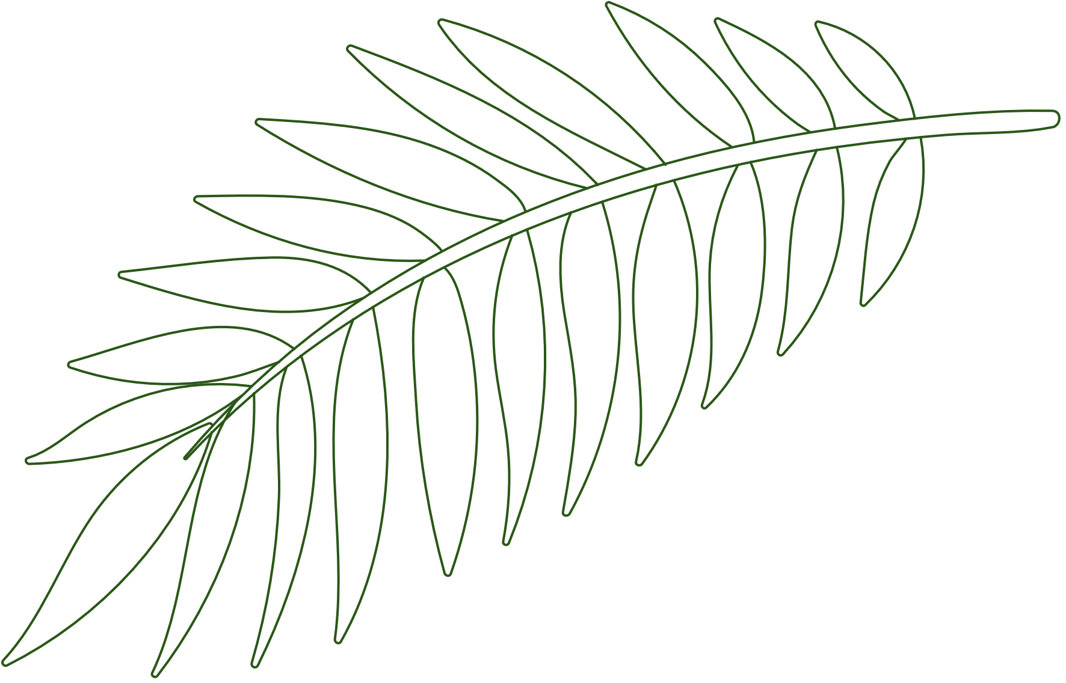

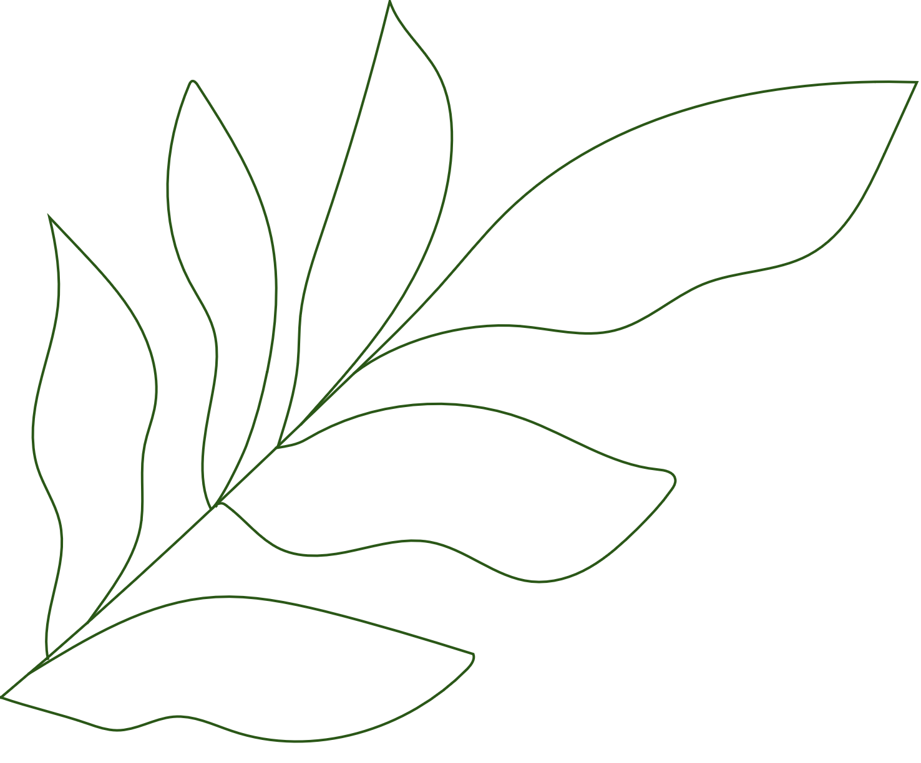


Smart Agriculture: Deep Learning for Detecting Plant Diseases Through Imaging
Presented By-
A023 Faria Khan
A034 Vinit Poojary
A038 Aishwarya Shirsat

Slide 2

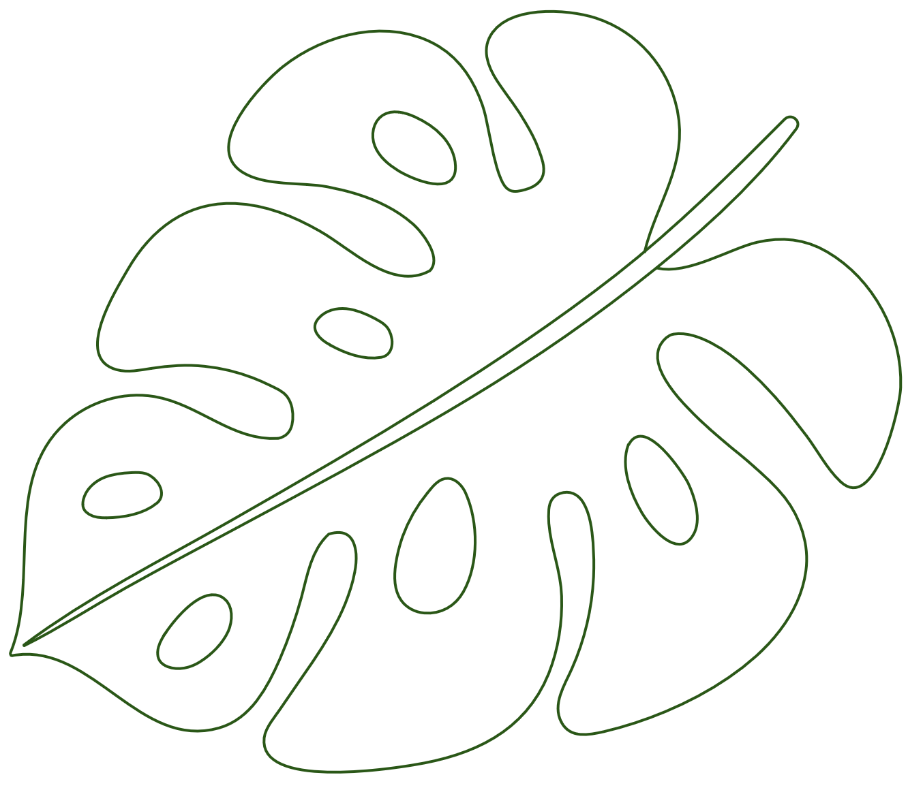

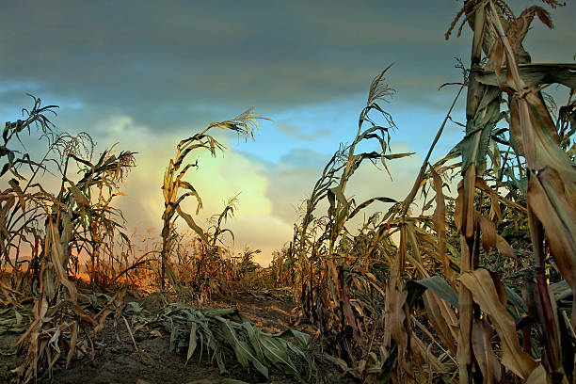


Business Problem
Plant diseases pose a significant threat to global agriculture, leading to reduced crop yields and economic losses. Traditional detection methods are often time-consuming, subjective, and require expert intervention.

Slide 3

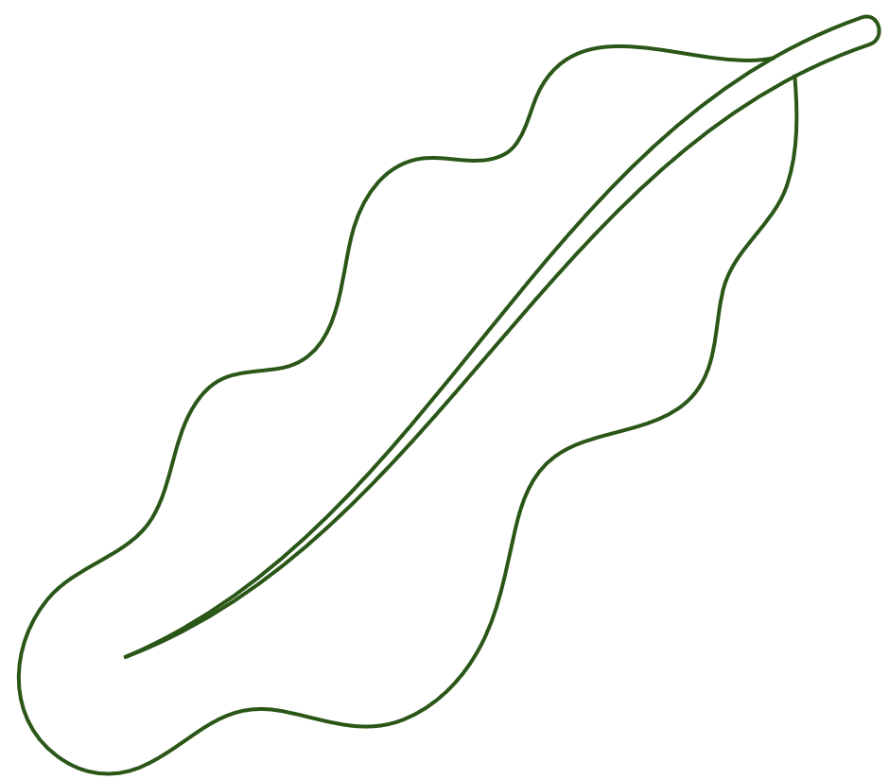

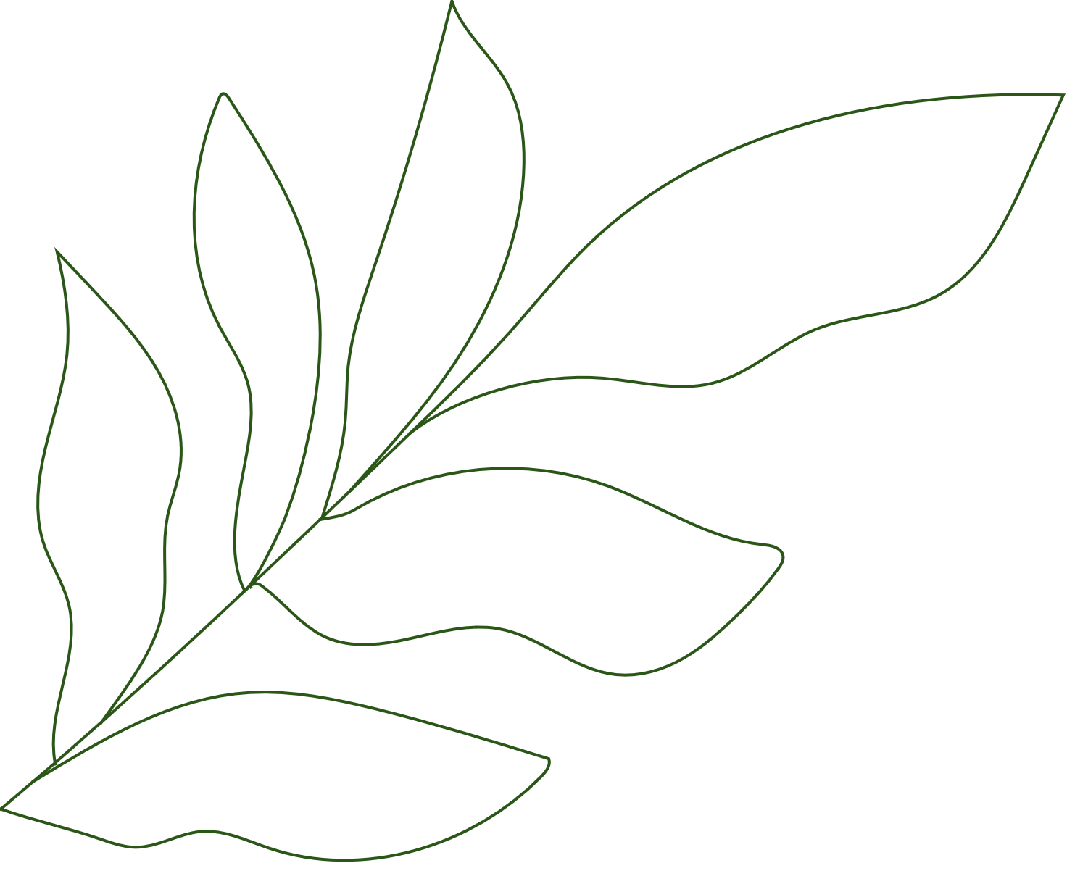
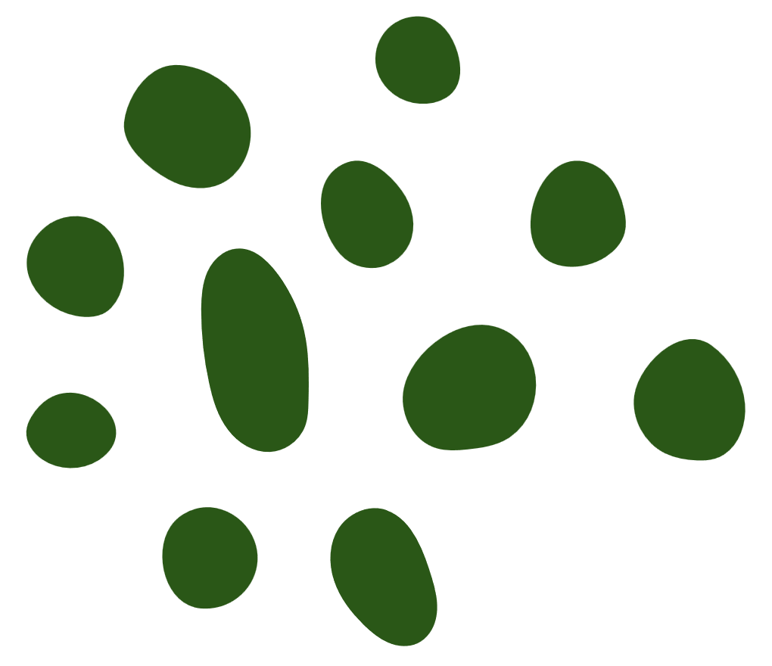
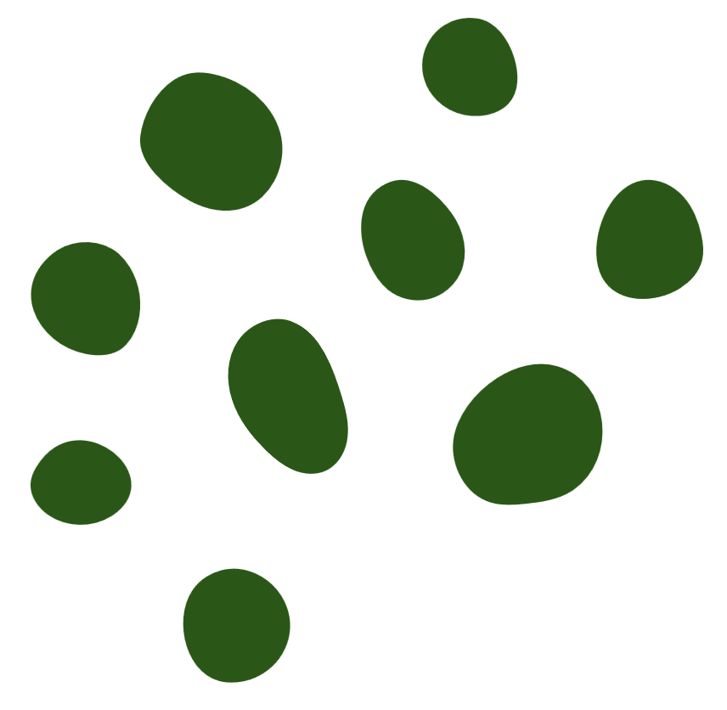

Business Problems as Data Science Projects
This project focuses on using deep learning techniques, particularly convolutional neural networks (CNNs), to develop an accurate and automated system for detecting plant diseases through imaging. By leveraging advanced image analysis, the solution aims to enable early disease detection, reduce dependency on manual inspections, and support sustainable agricultural practices.

Slide 4
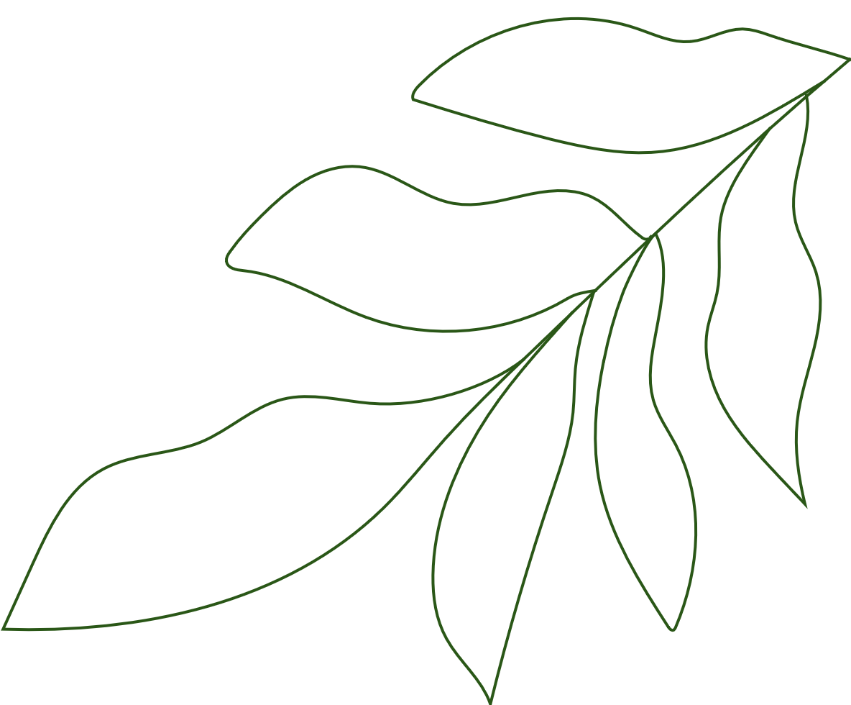




Literature References
Li, L., Zhang, S., & Wang, B. (2021). Plant disease detection and classification by deep learning—a review. IEEE Access, 9, 56683-56698.
1
Shoaib, M., Shah, B., Ei-Sappagh, S., Ali, A., Ullah, A., Alenezi, F., ... & Ali, F. (2023). An advanced deep learning models-based plant disease detection: A review of recent research. Frontiers in Plant Science, 14, 1158933.
2
Mohanty, S. P., Hughes, D. P., & Salathé, M. (2016). Using deep learning for image-based plant disease detection. Frontiers in plant science, 7, 1419.
3
Ahmad, A., Saraswat, D., & El Gamal, A. (2023). A survey on using deep learning techniques for plant disease diagnosis and recommendations for development of appropriate tools. Smart Agricultural Technology, 3, 100083.
4

Slide 5


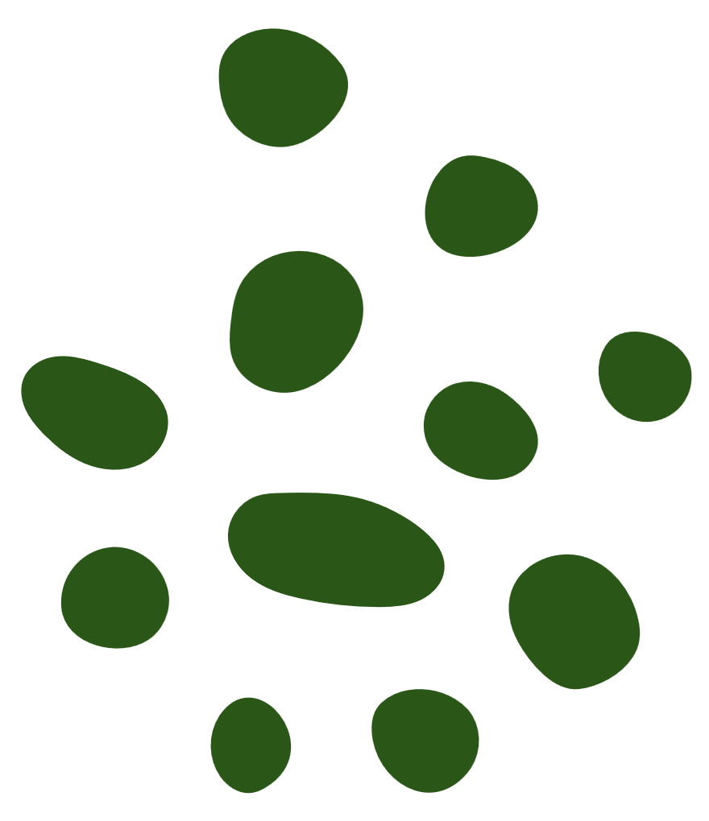

ALGORITHMS USED
01
02
03
Supervised Learning
Unsupervised Learning
Deep Learning
Classification:
Random Forest, SVM, k-NN
Neural Networks:
CNNs for image-based analysis
Clustering:
k-Means for grouping similar diseases
Dimensionality Reduction:
PCA for feature extraction
Transfer Learning:
ResNet, VGG, Inception
Autoencoders: For anomaly detection in plant images

Slide 6


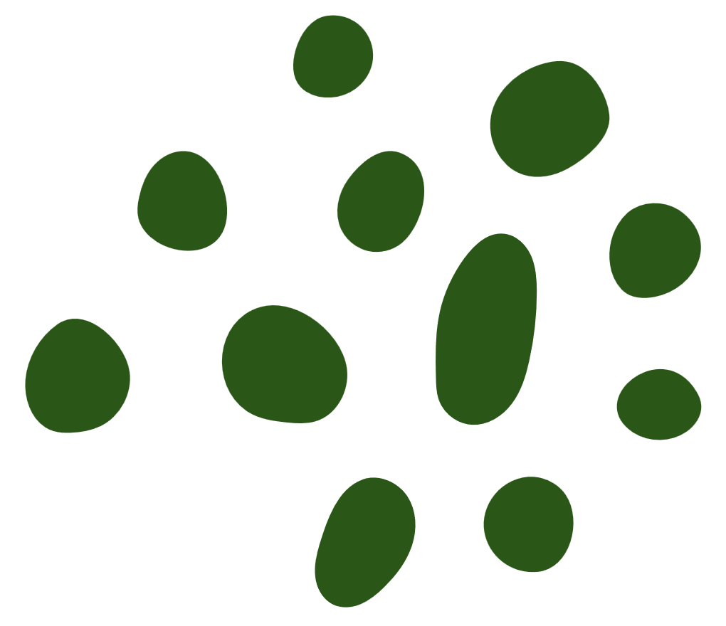


Models Overview
Image Classification Models
CNNs: To detect diseases from plant leaf images
Pre-trained Models: Fine-tuned ResNet or EfficientNet for specific disease datasets
Object Detection Models
YOLO, Faster R-CNN: For identifying and localizing diseases in plant regions
Segmentation Models
U-Net, Mask R-CNN: For identifying diseased areas on plant leaves
Generative Models
GANs: For augmenting datasets by generating realistic diseased leaf images

Slide 7


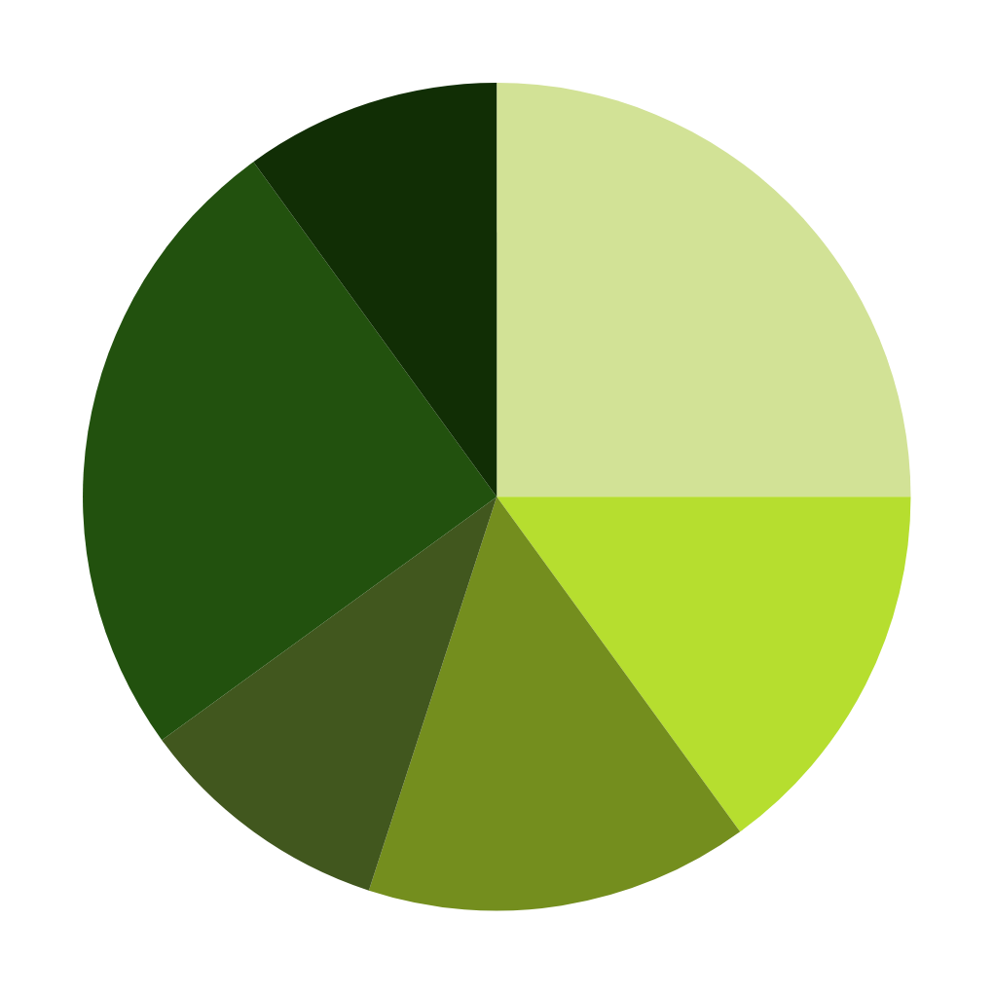

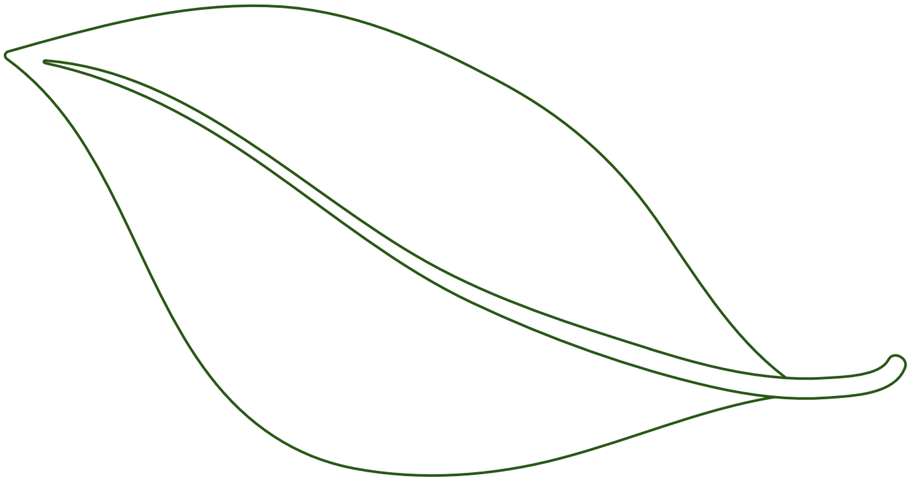

Toolsets and their Usage
Labeling Tools
(LabelImg, Roboflow)
Programming Tools (Python & R)
Coding Platforms
(Google Colab,
Jupyter Notebook)
Deep Learning Frameworks (TensorFlow/Keras & PyTorch)
Big Data Tools (Apache
Hadoop or Spark)
Visualization Tools
(Matplotlib, Seaborn,
Plotly & OpenCV)

Slide 8
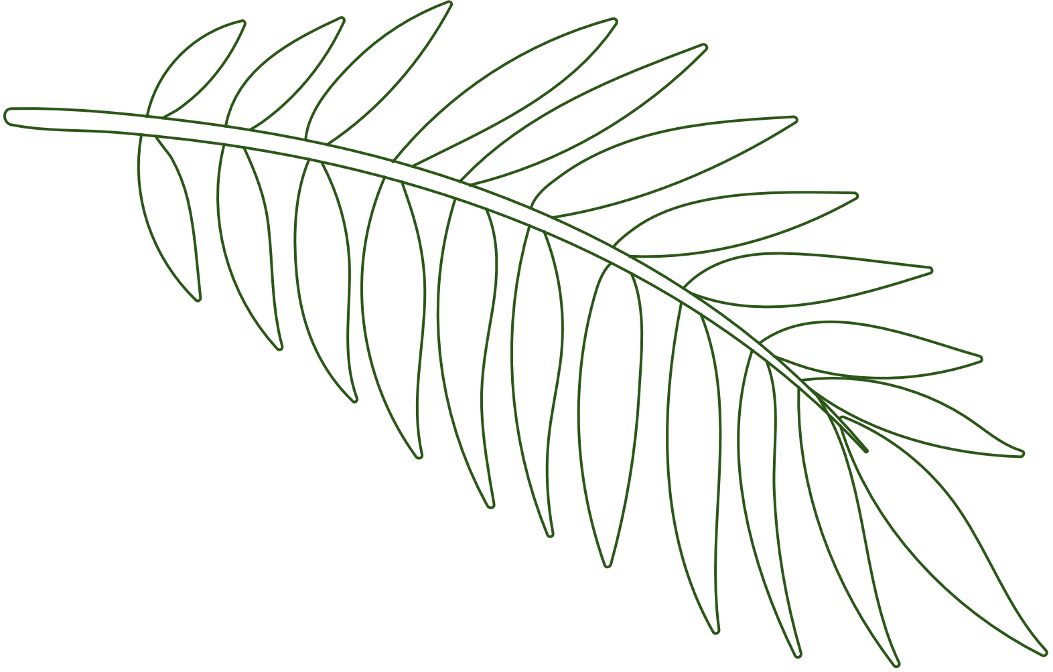






Dataset Overview
Plant Village Dataset: A popular dataset with annotated plant leaf images for disease detection
Click here : Dataset Link
01
Kaggle Datasets: Various curated plant pathology datasets
Click here : LeafDetectionLink
02

Slide 9





Conclusion
Today, we talked about how smart agriculture is using deep learning to help detect plant diseases. This technology makes it easier and more accurate to check the health of plants. By using powerful neural networks and well-organized data, farmers can quickly identify problems and take action. This not only helps them prevent crop losses but also supports more sustainable farming methods. In short, these technologies mark an important step forward for modern agriculture, helping to ensure a healthier and more efficient food production system.

Slide 10
Thank You!

